Slide 1
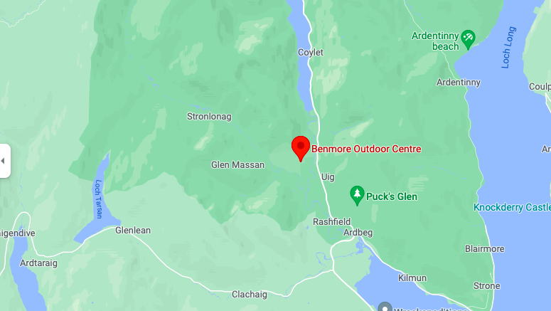
Benmore Outdoor Week
3rd - 7th March 2025

Slide 2
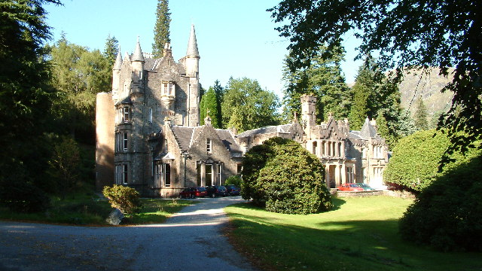
Benmore House

Slide 3


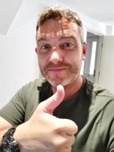


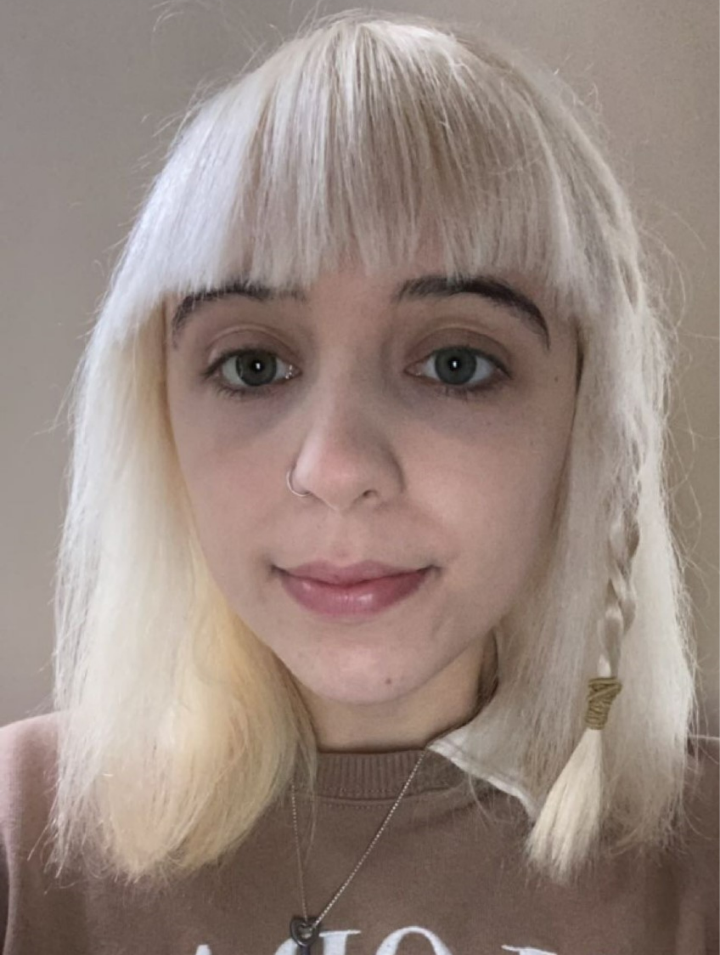
Who is Going?
55 children in P7
6 Castleview adults
Katie Watson
Principal Teacher & P7B Class teacher
Matthew Williams
P7a Class Teacher
Paul Archibald
Senior Early Years Officer
Susan Martin
PE Specialist
Yuliya Herasymenko
Pupil Support Assistant
Freya O’Horo
Pupil Support Officer

Slide 4
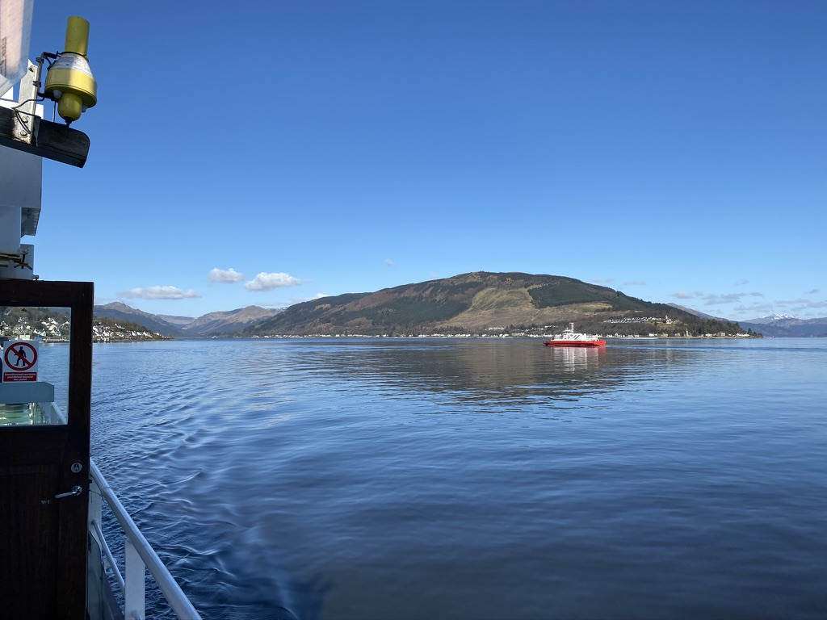
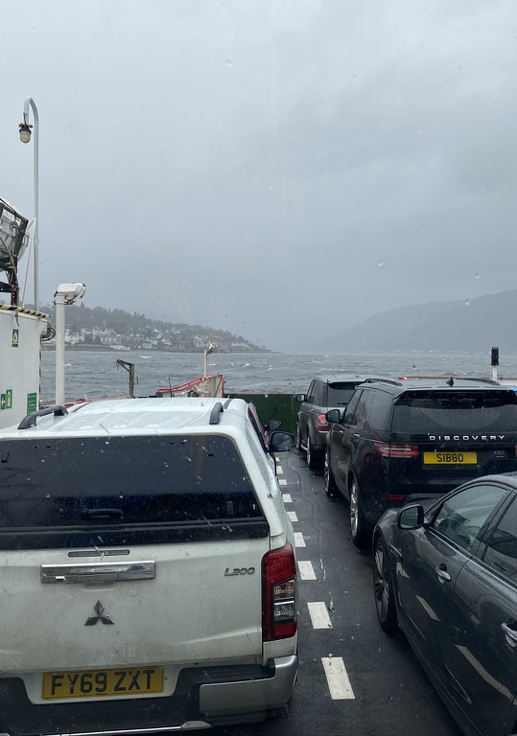
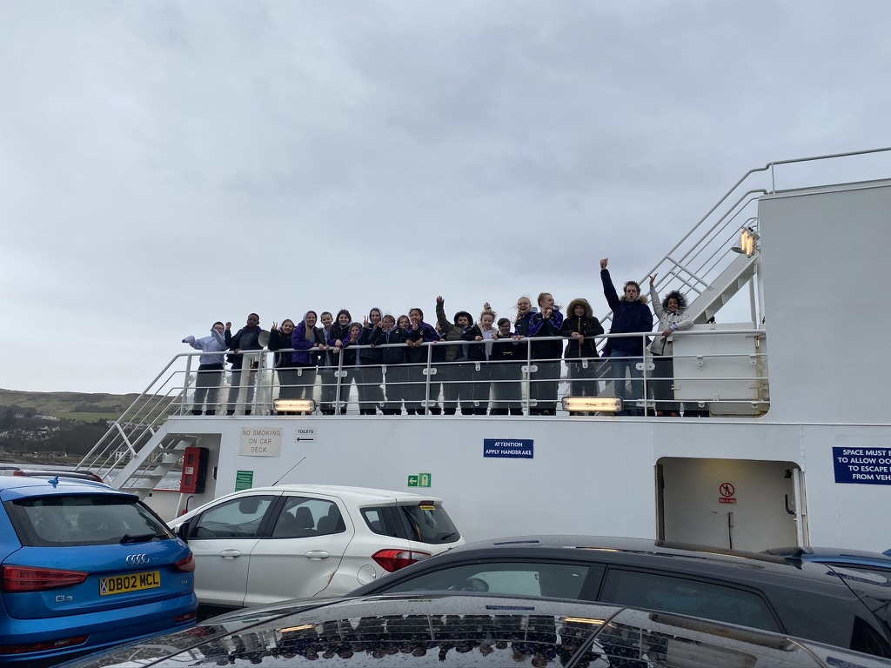
How Do We Get There?
Coach – leaves school Monday at ~10.00am
Children dropped off at normal start of day with suitcase
Transfer items for coach into school backpack
Wave goodbye as bus departs
Packed lunch at Gourock (Battery Park)
Ferry across to Dunoon
Arrive at Benmore early afternoon.

Slide 5
Day One - Monday
Dorms
Meeting to discuss the week
A look around the Centre
Allocation of outdoor gear
Afternoon tea
Free time/showers
Dinner
Night Walk
Bed at 9pm – lights out 9.30pm.

Slide 6
Days 2 – 4 – Tuesday - Thursday
Morning
08.00 – Wake up and dressed
08.30 – Breakfast
09.00 – Duties (rota on back of dorm doors)
09.30 – Room inspections
10.00 – Briefing for first activity
1.00 – Return to centre for lunch.
Afternoon
2.00 – Briefing for second activity
5.00 – Return to centre for afternoon cake
6.00 – Dinner
7.00 – Daily diary writing
7.30 – Evening activity
9.30 – Lights out & bedtime stories.

Slide 7
Day 5 - Friday
8.00 – Wake up and dressed
8.30 – Breakfast
9.00 – Room cleaning and packing
9.30 – Final room inspections
10.00 – Bus loaded
10.30 – Bus departs.
Return ferry
Snack on bus
Arrive back at Castleview at lunchtime (actual time confirmed by text on the day).

Slide 8
Dorm Allocations
Boys – Tower - 5 dorms – 24 boys
Girls – North Wing - 6 dorms – 31 girls
Adult on each floor
Children asked who they wished to share with – children are guaranteed at least 1 of their choices
Allocated dorms based on preferences and dorm size

Slide 9
Activity Groups
Mixed gender groups.
Not the same as dorm groups.
Always ensure they have one good friend in their group.
Group Leader from Benmore Centre runs the activity.
Teaching staff member there to support, manage behaviour, encourage and join in.
Teaching staff will take photos for Twitter, website and yearbook.

Slide 10
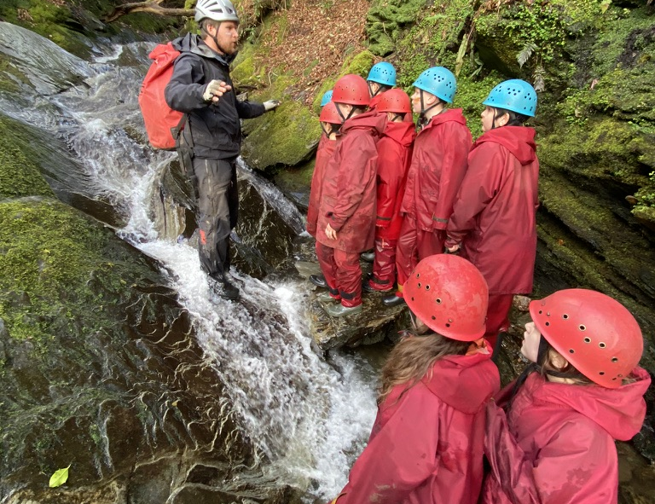
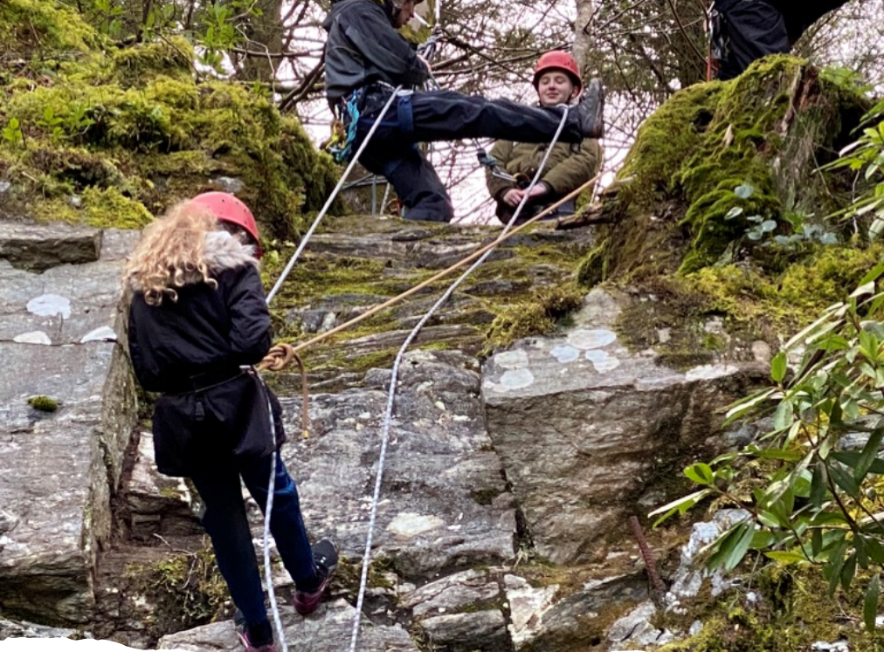
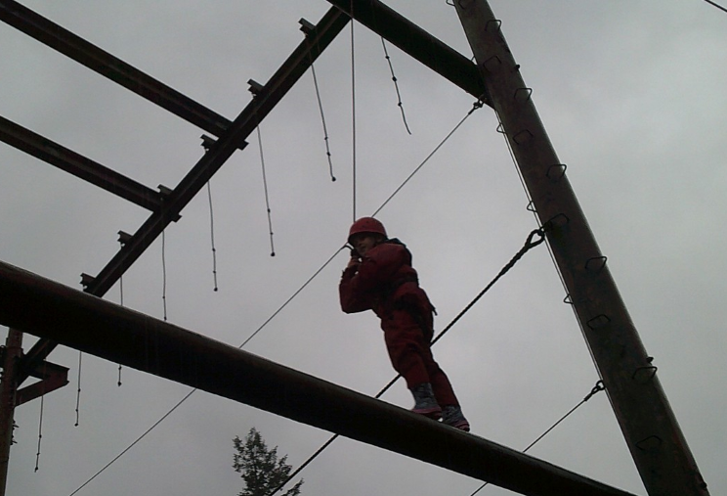
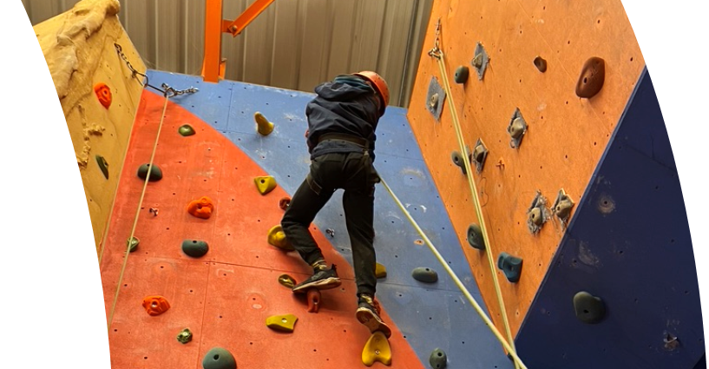
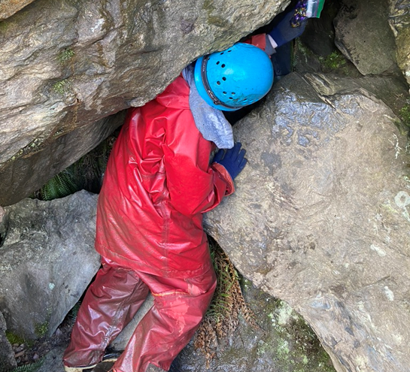
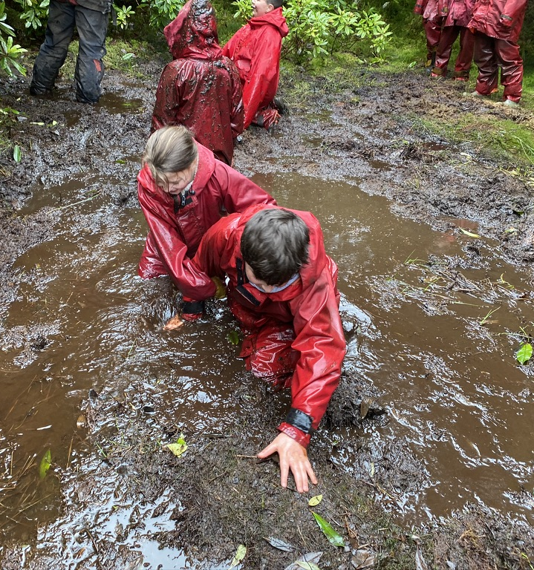
Different activities on offer:
Night walk Forest walk
Gorge walking Orienteering
Abseiling Rock Climbing
Caving Mountain Biking
Raft building Canoeing
High ropes course
And more…

Slide 11
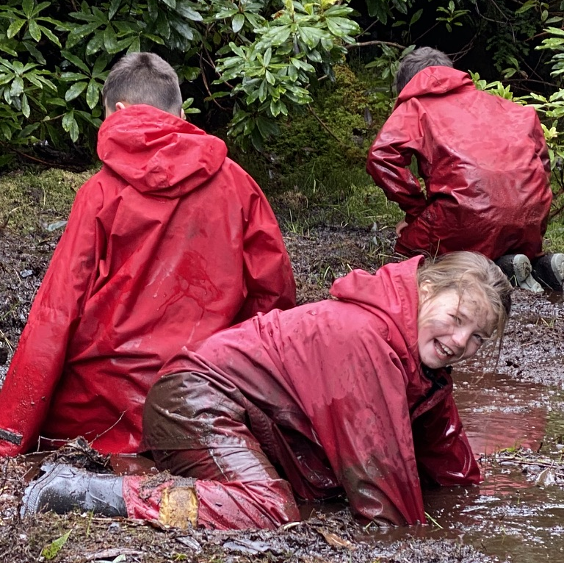
Equipment
Centre provides outdoor waterproofs
Wellingtons
All safety equipment

Slide 12
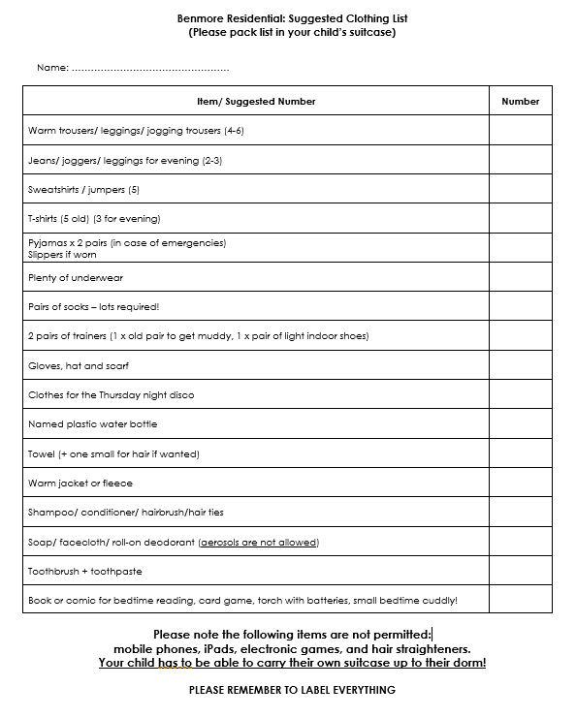
What Your Child Needs to Bring

Slide 13
Why Benmore?
To create memories that will last a lifetime – we all still remember our first trip to camp!!!!
To get out into the fresh air and beautiful countryside.
A chance to bond as a team.
An opportunity to try new things.
To find out what you are capable of.
To push yourself to do something that scares you.
To learn to be more independent.
Time away from everything (including family ☺!)

Slide 14
Non-negotiable Behaviours
listening and following instructions (safety!)
showing respect to adults (school reputation with external staff)
respect for school property (Benmore House is a historic property)
consistently taking part in PE and outdoor learning (refusal in group activities would mean the whole group misses the activity and returns to Benmore House)
kindness (children are away from home so everyone needs to feel safe)
supportive of others during activities (some activities are scary and everyone needs to be a cheerleader.)

Slide 15
Fundraising for Benmore - TBC
Benmore costs £450 per child, roughly £25,000 – school pays!
We do ask for your support in fundraising for Benmore.
In the past, parents have formed their own fundraising group and have worked with the school to raise as much money as possible for Benmore.
This year our fundraising events are:
Christmas Fair
Car wash
Sponsored walk to Benmore
Benmore bake off -6th Feb Parents night
Benmore Bingo – 25th Feb 4:15pm
Please support with these

Slide 16
Ramadan
First full week of Ramadan during Benmore
Last year provisions were made to ensure that all our pupils observing Ramadan could still attend Benmore including providing dedicated rooms for prayer and adapting meal times
We had 4 pupils who chose not to fast during Benmore and completed an addition week of fasting once they returned from Benmore
Please come and discuss this with us at the end of the meeting if you have any further questions or queries

Slide 17
Frequently Asked Questions
What contact will there be from our children?
Children will not be able to take their mobile phones with them.
Phoning home can only make homesickness worse, so we discourage children from asking to call home. However, if a child desperately needs to speak to their parent, we will of course ensure that they are given access to a phone at Benmore.
Parents will be able to check in on Twitter every day to see what activity groups have been up to.

Slide 18
Frequently Asked Questions
Dietary Requirements
Benmore Centre caters for dietary requirements such as vegetarian and Halal, as long as these were indicated on the KIC form.
How will families without social media be able to get updates?
The school office will be happy to give you an update of what is happening during the week if you pop into school. If there was a problem with your child being unhappy or unwell at Benmore, a member of staff would telephone you to make you aware of this on the day it happened.

Slide 19
Frequently Asked Questions
What medications can my child bring?
As with normal school policy, if your child requires any medication (prescribed and unprescribed – e.g. asthma inhaler, Paracetamol, Ibuprofen, hay fever medication or vitamin tablets) we would need you to fill in the necessary paperwork authorising us to give this as prescribed/if needed.
If your child is known to suffer from travel sickness, please ensure you send medication with your child for this.
We will also ask that every child has permission to take a travel sickness tablet on the coach to avoid us having to try to phone you on the journey if your child suddenly becomes unwell.
PLEASE FILL IN MEDICATION PAPERWORK TODAY

Slide 20
Frequently Asked Questions
Will the children need spending money?
The children should bring no more than £5 of their own money with them. This will need to go In a named envelope and the staff will keep it locked in a safe place until the souvenir shop opens. The shop sells Benmore memorabilia and trinket toys.
Can the children take their own snacks?
Only one healthy snack for the journey (more is not great for travel sickness!).
The children will need a packed lunch for the journey.
They may bring 1 snack (bag of sweets etc) in their suitcase to share out during the week.
The food at Benmore is excellent and plentiful, and there is cake provided every afternoon, so it shouldn’t be necessary to overload your child with extra food.

Slide 21
Frequently Asked Questions
Will there be other schools at Benmore?
We usually go to Benmore with one other school. However, we have dormitories in different areas of the house, separate activities and separate spaces allocated for meals.
The only time the children would be together would be at the disco on the Thursday night.
Does my child have to go to the Disco?
Some children find the disco overwhelming and choose not to go. There is a quiet room with a film, games and activities for those who wish to do something quieter instead.

Slide 22
Frequently Asked Questions
If my child runs out of something, what happens?
If you follow the guidelines on the packing list that has been sent home, this is unlikely to happen.
However, if your child runs out of dry, clean clothes then we will make sure that sufficient items are made available to get them through the week.
Lots of pairs of socks (at least two pairs for each day) is probably the most important one!

Slide 23
Any further questions?

Slide 25
Our Benmore Charter
Benmore is a once in a lifetime experience, and we want everyone to get the best from it.
You will be away from home, perhaps the first time away from your parents and carers, doing activities that put you well outside your comfort zone, and that need you to be able to listen and follow instructions to keep yourself and others safe.
You will be staying in a 19th Century listed manor house (1851), with external staff who are not part of our Castleview team.
There will be at least one other school at Benmore at the same time as we are there.
You will be representing Castleview and our school values.

Slide 26
Essential Behaviours
What behaviours do you think
we all need to display
to ensure that Benmore is a
happy, safe and positive experience for everyone
(children, Castleview staff and Benmore staff).

Slide 27
How We will Apply the Charter
Teachers will have a sheet with each point on the charter on it, and will add initials of any child who breaks a promise from the charter - tally marks will show how many times beside their initials.
We will consistently apply the usual process of recording and contacting parents to any tally mark recorded.
Review at the end of January with a warning to any pupil who needs it, plus a phone call/letter to parents to explain that the warning has been issued that the Benmore trip is at risk.
Review again before the Feb break, if behaviour still hasn’t changed. Meet with parents of anyone we aren’t comfortable taking.

Slide 28
Please remember ….
Castleview is the only school in Edinburgh that pays for the children to go to Benmore. It costs ~£450 per child.
Staff give up their personal time to take you to Benmore.
We do not get paid extra for being with you 24 hours a day instead of the normal 6 hours per day.
We leave behind our own children and loved ones for the week.
We will not take anyone who is not willing to accept responsibility for their actions and behaviours, who we consider to be unsafe, or who doesn’t respect us or the values we teach at Castleview.

Slide 29
Thank you

